Slide 1
JOURNEY SCRAPBOOK
Custom Bootcamp (29th August – 6th October)
Week-6
Anushka Dhir
Batch-6

Slide 2
DAY-1
What is Machine learning and its uses in daily life ?
Types of machine learning algorithms :
Supervised
Unsupervised
Semi-supervised
Reinforcement
Overview of Azure ML Studio
Notebooks and Pipelines
Azure ML Designer
Machine Learning – Day 1

Slide 3
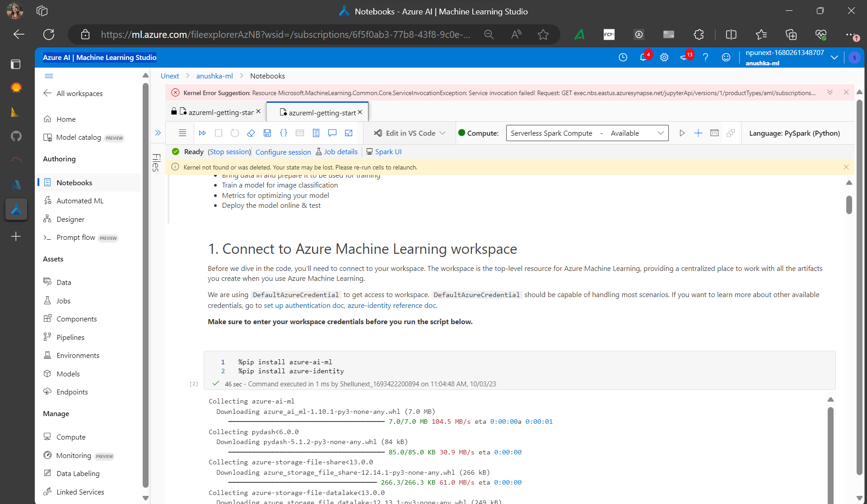
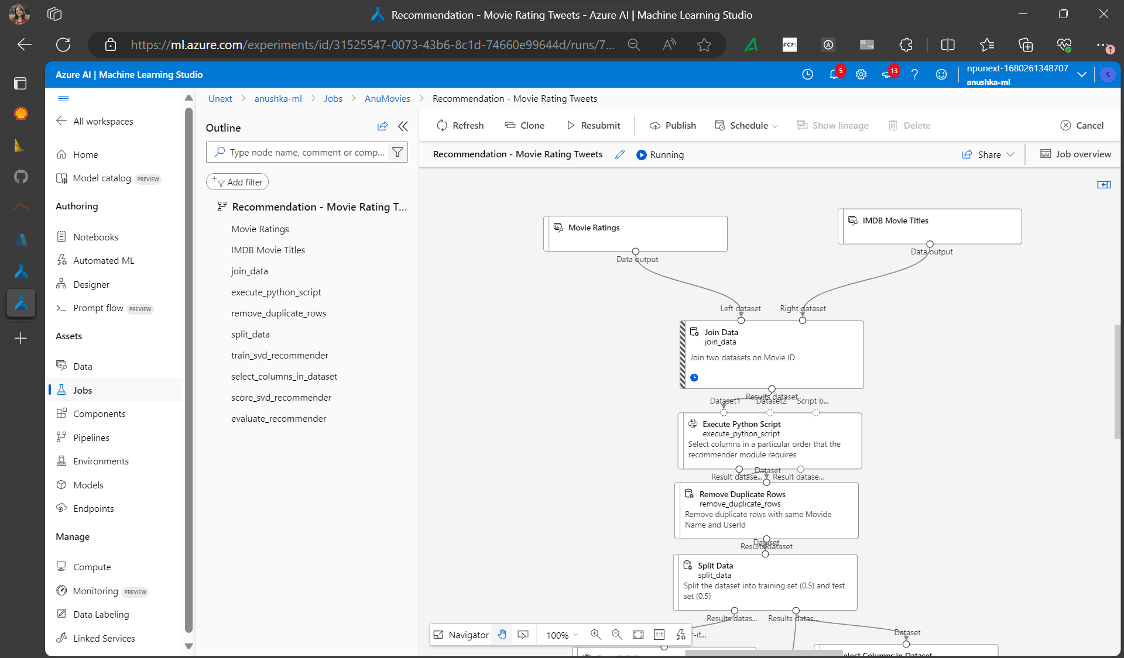
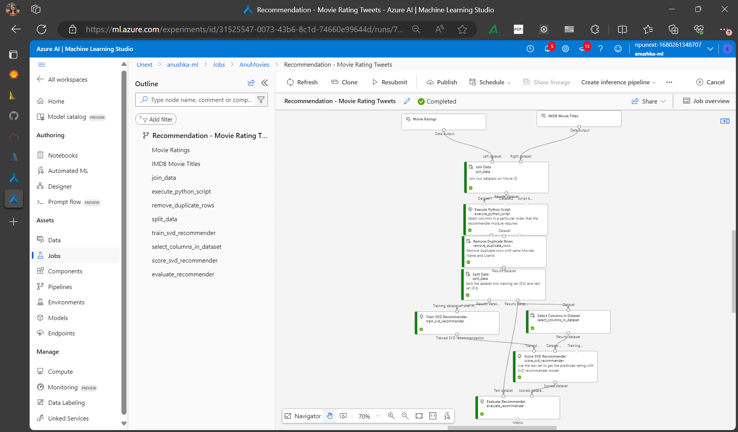

Slide 4
DAY-2
Azure ML Studio Pipelines
Tune model Hyperparameters
Automated ML
Machine Learning – Day 2

Slide 5
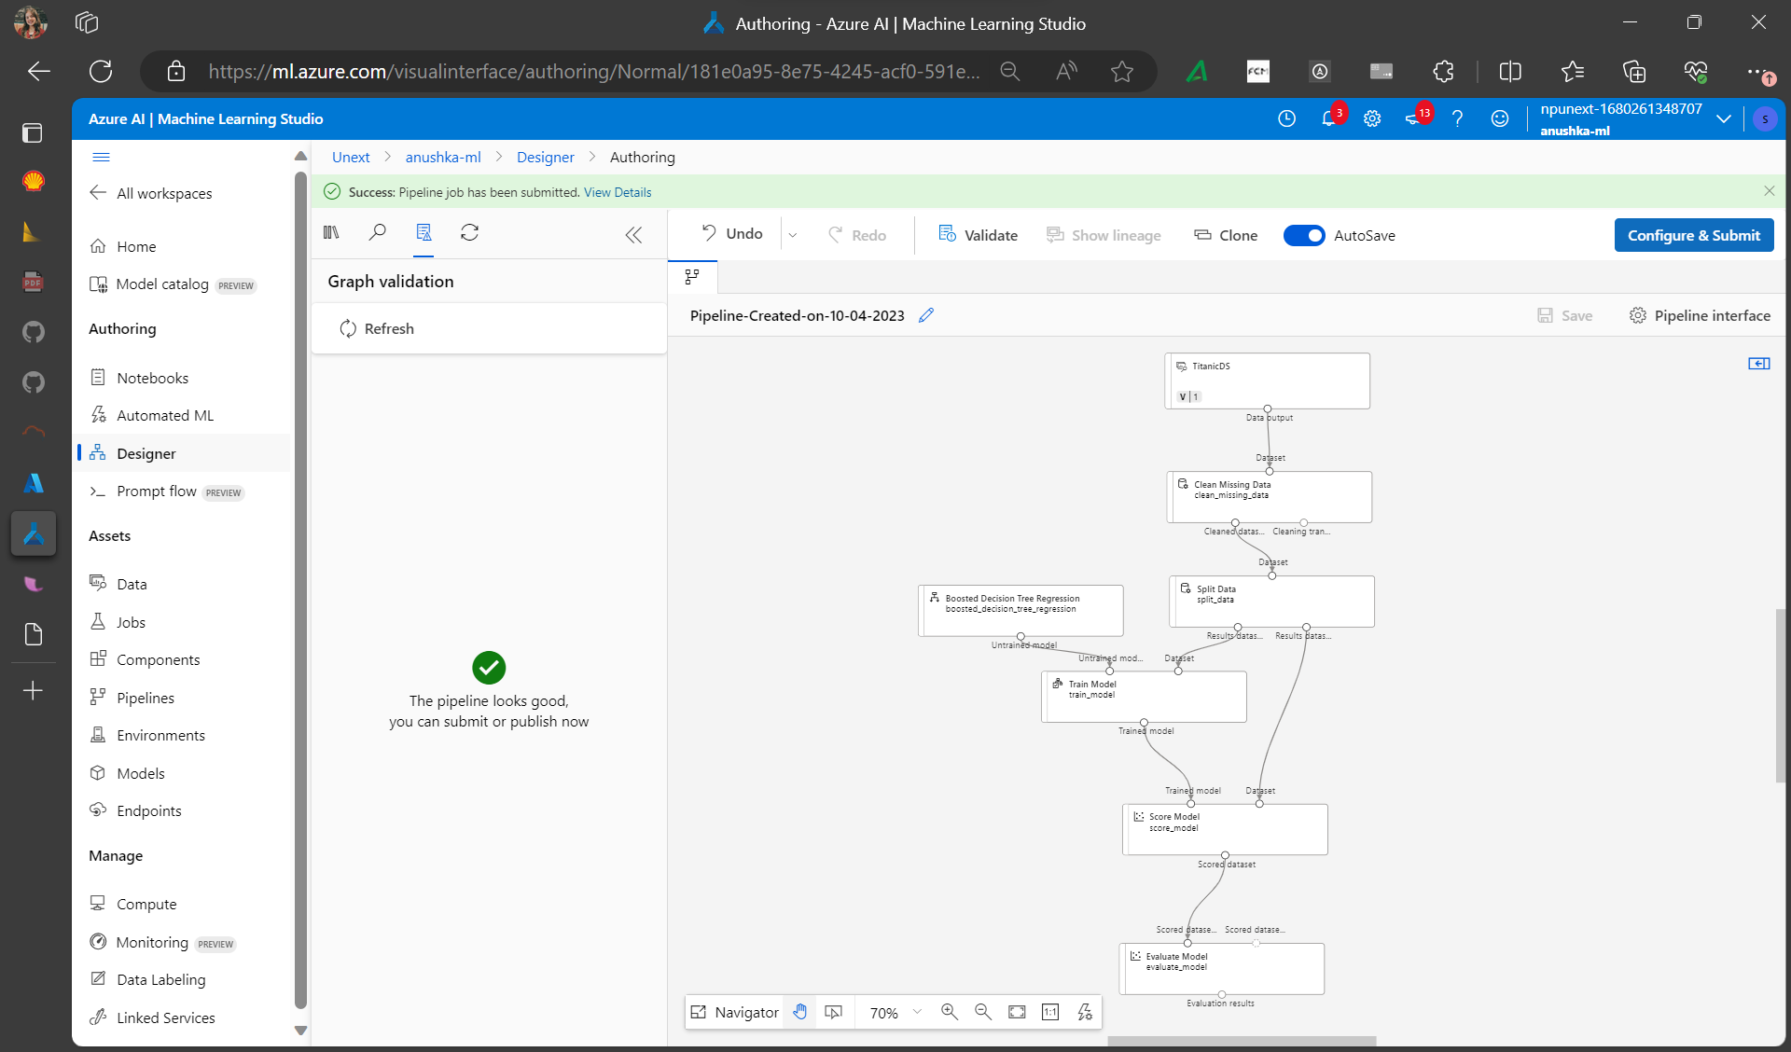
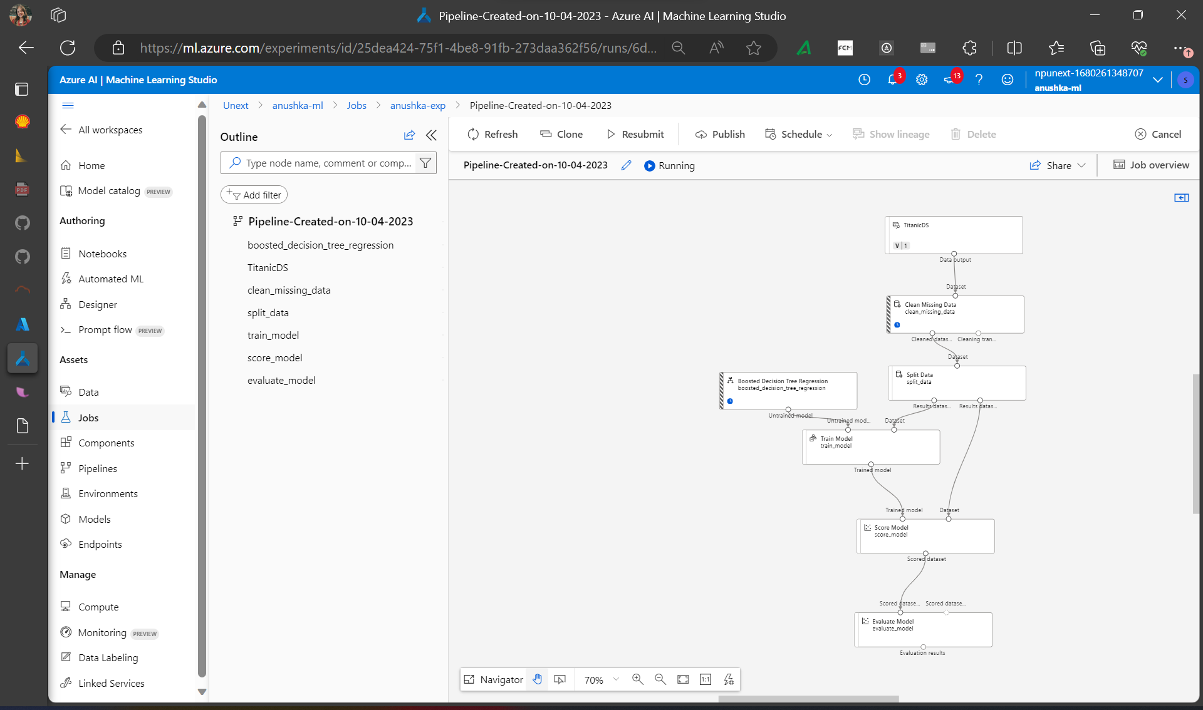
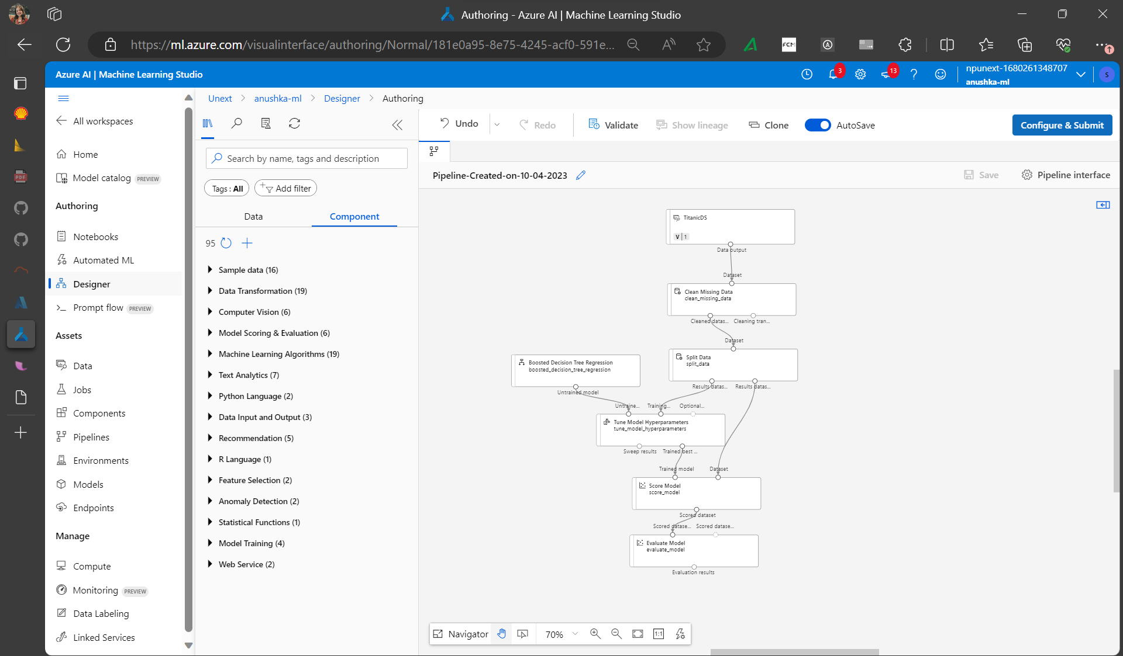
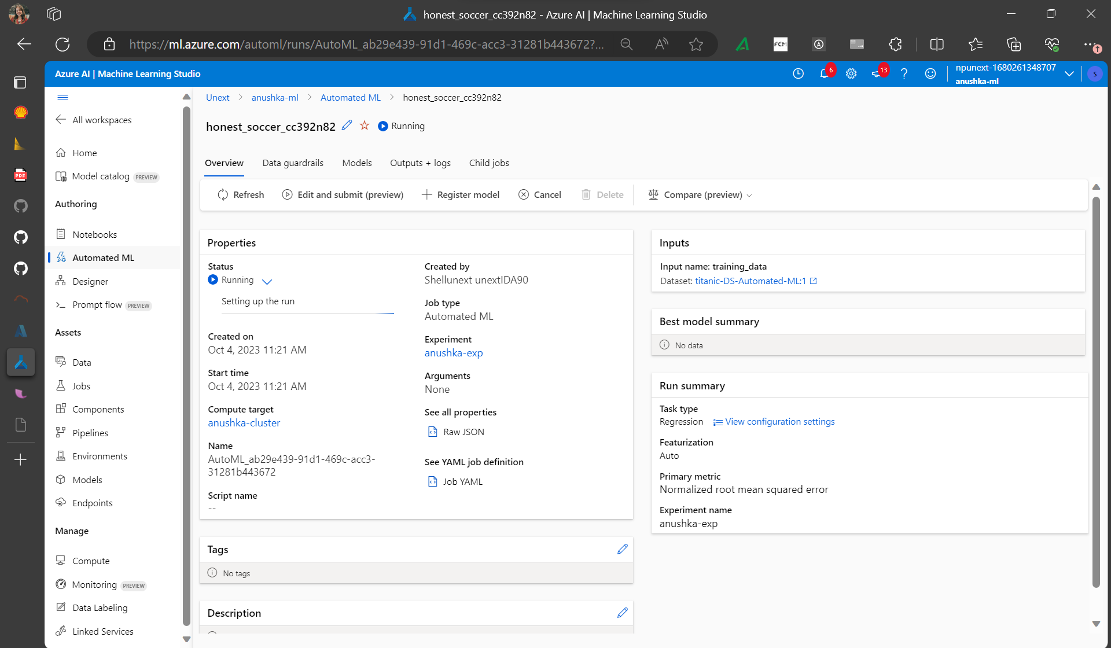

Slide 6
Thank You

